Slide 1

Watson Assistant Labs
Lab 2: Chatbot Integrations

Slide 2
Objective
Use Watson Assistant integrations to access your chatbot using:
a web-hosted chat widget you can use for testing
a third party chat service (Slack)
a live, publicly available web-hosted version of your chatbot

Slide 3
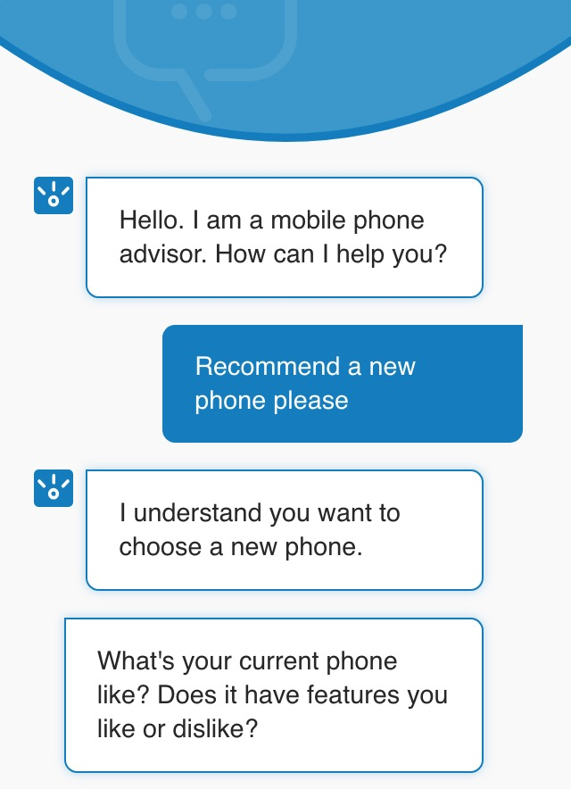
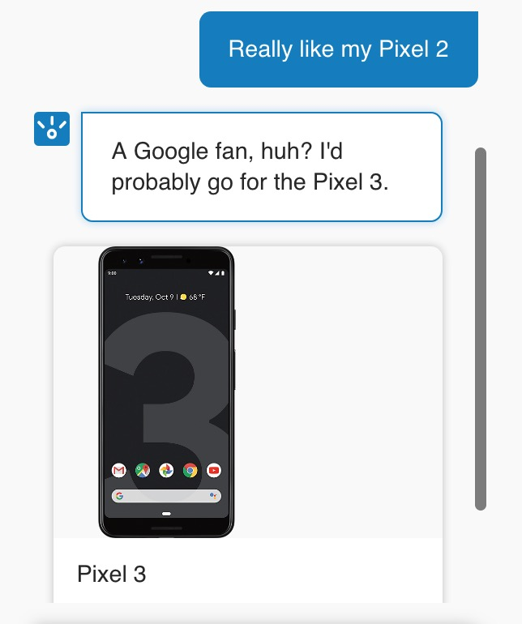
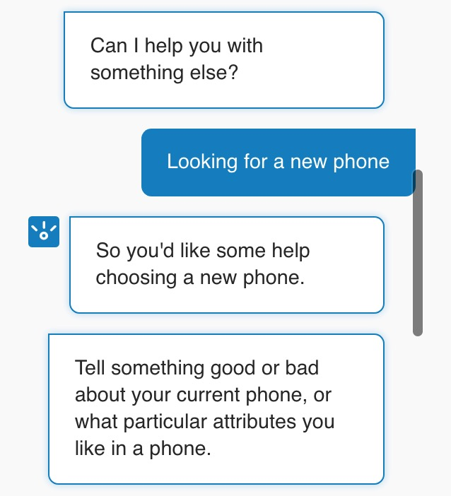
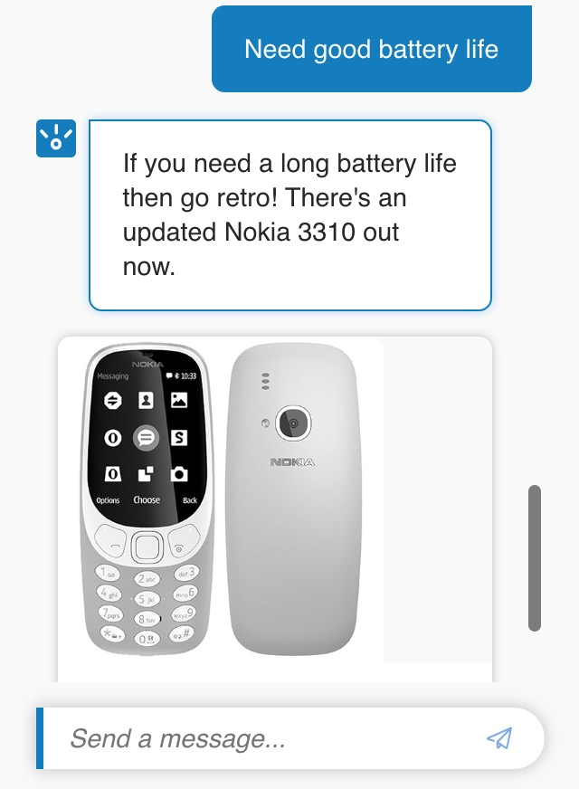
Objective

Slide 4
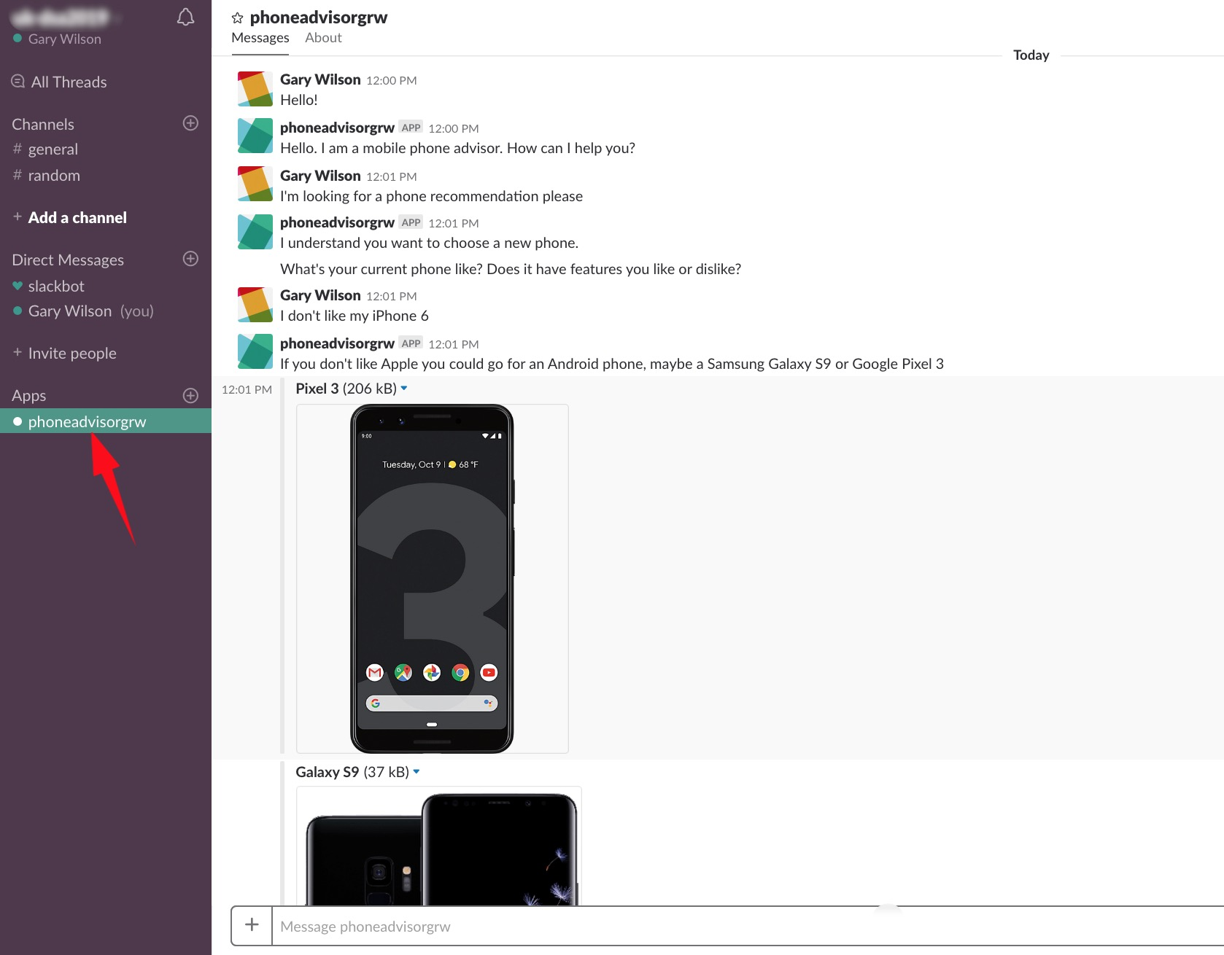
Objective

Slide 5
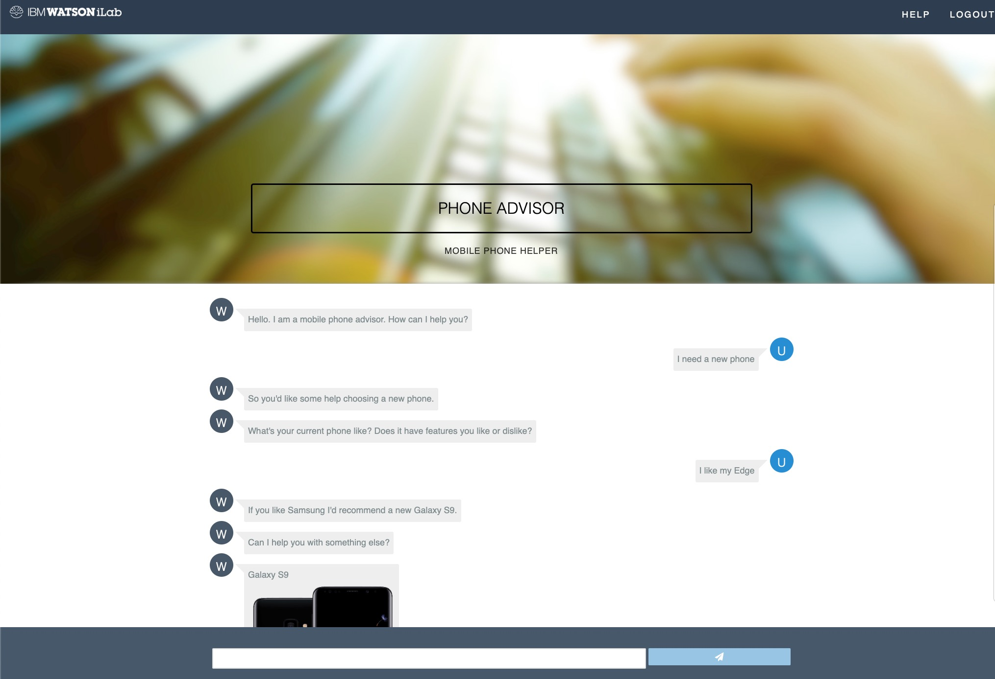

Slide 6
Agenda
Create an Assistant for your skill
Create a Preview Link: a web widget to test your chatbot
Build a Slack bot
Setup a live web-hosted chatbot

Slide 7
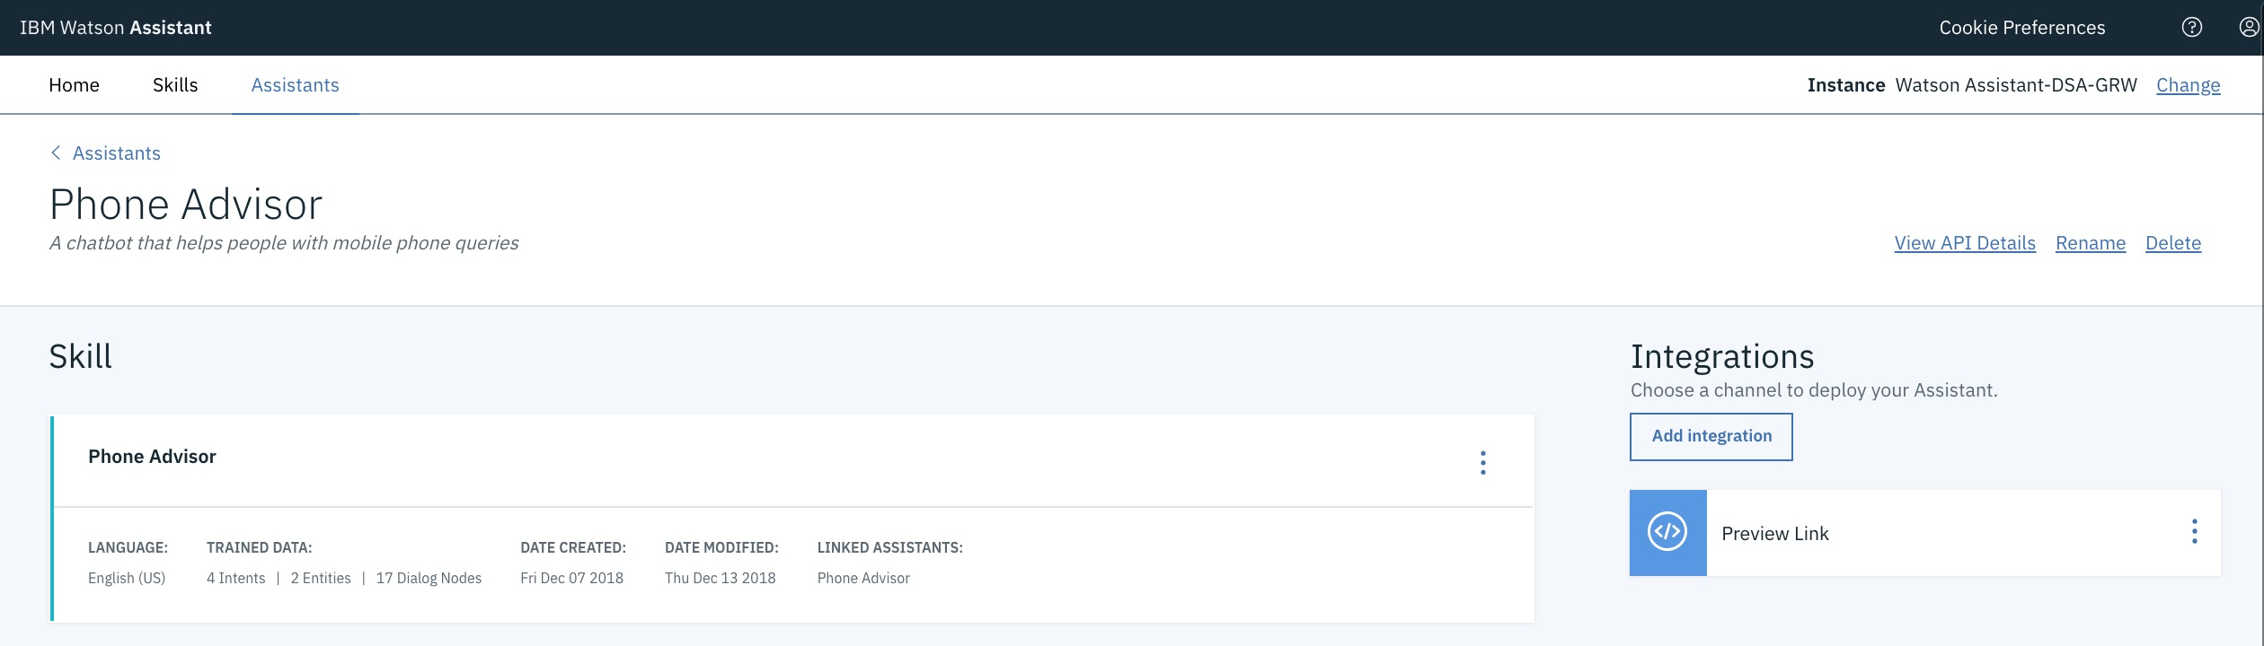
Integrations & Assistants
An assistant is the user-facing component that manages the flow of information between your skills and your end-users
Assistants allow you to create integrations that publish your chatbot to the channels where your users go for help
e.g. Slack, Facebook Messenger, Wordpress

Slide 8
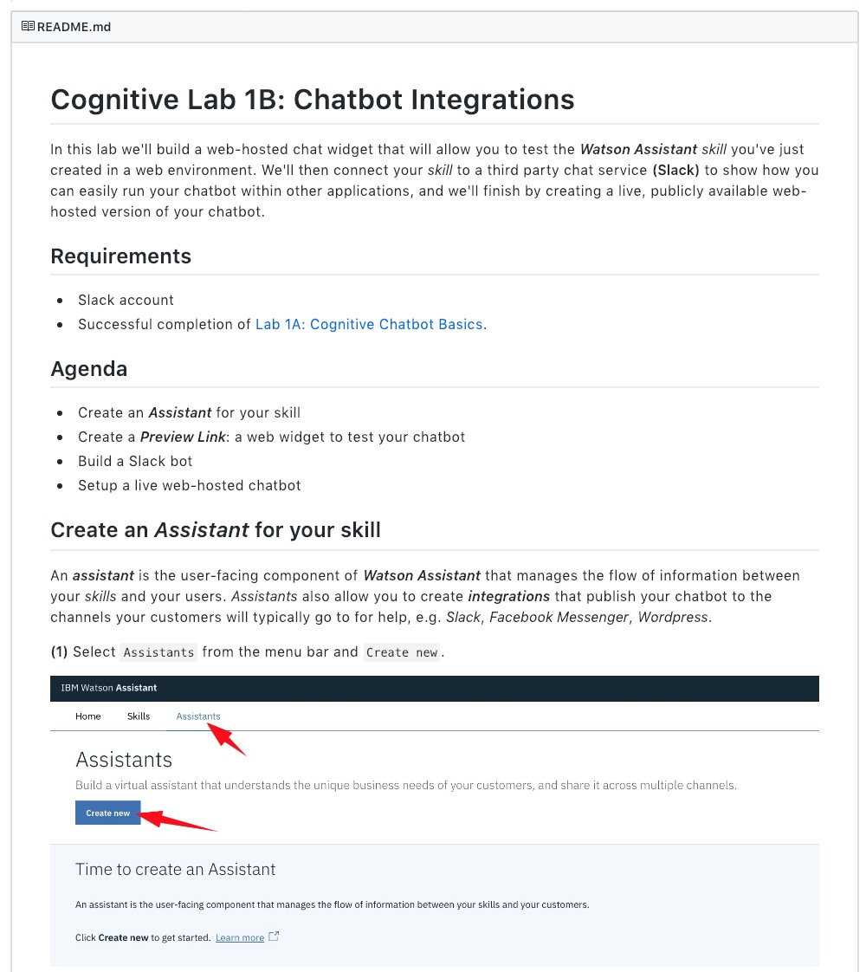
Lab Format
Step-by-step instructions
GitHub README.md for each lab
Work at your own pace
https://github.com/garyrwilson/Watson-Assistant-Labs/2-Integrations

Slide 9
Watson Assistant Labs
Lab 2: Chatbot Integrations

